Slide 1

STABILITY AND STABILIZATION OF NETWORKED LOAD FREQUENCY CONTROL SYSTEMS INTEGRATED WITH ELECTRIC VEHICLE (EV) AGGREGATORS.
Presented By:
Sharini Rithigaa B S (17CE153)
Gokulnath M (17EE111)
Kalavagunta Vamshi (17EE118)
Kalla Anil Sai Kumar (17EE119)
Under the guidance of, Dr. K.Ramakrishnan, M.E., Ph.D.,
Associate Professor,
Department of EEE.

Slide 2
Objectives of the project:
In this project , stability analysis and stabilization of a single-area load frequency control system integrated with electric vehicle aggregator over a communication network will be investigated.
The use of open communication channel in the closed loop control of load frequency systems integrated with EVA introduces time-delays in feedback loop.
Time delays affect the overall performance and stability of the dynamic system. If the delays induced by the communication network goes beyond a critical margin, the closed loop system loses stability.
In the first phase of the project the problem of stability will be addressed where in the focus would be to compute the maximum value of the network–induced delay within which the LFC system with a pre designed PI controller, remains asymptotically stable.

Slide 3
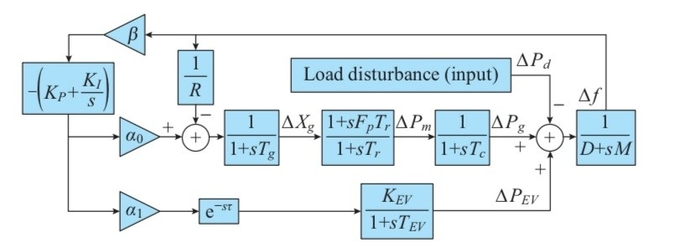
LOAD FREQUENCY CONTROL SYSTEM INTEGRATED WITH EVA:
Fig. 1. System model of single-area LFC with EV aggregator.

Slide 4
Description of test system:
In the test system, a single area LFC system with conventional generation unit (governor-turbine-synchronous generator) is employed as the main source for feeding the load.
A fleet of plug-in vehicles, called Electric Vehicle Aggregator (EVA) are integrated to the LFC system.
The conventional generation and EVA are controlled using a PI controller. For conventional generation units, the controller is locally available and for EVA, the control is done through remote mode.
The power generation of EVA is controlled by the PI controller using a communication channel owing to their geographical dispersement. This introduces time-delay in feedback path.
The participation factors decides the load sharing among conventional generation and EVA.

Slide 5

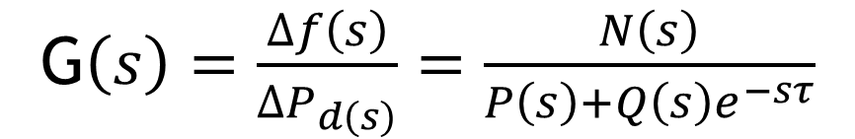
Closed loop Transfer function:
The closed loop transfer function of the time-delayed load frequency control system relates Δf(s), the incremental frequency variable (output variable) to load disturbance variable Δ$P_{d}$(s) (input variable).
The closed loop transfer function is derived as follows:
Where,
N(s)= $n5$s⁵ + n₄s⁴ + n₃s³ + n₂s² + n₁s¹ +n_{0.}
P(s) = p₆s⁶ + p₅s⁵ + p₄s⁴ + p₃s³ + p₂s² +p₁s + p_{0.}
Q(s)= q₄s⁴ + q₃s³ + q₂s² +q₁s +q_{0.}
The characteristic polynomial involves time-delay term e^{-s}$τ$ Hence, time-delay affects the stability of the closed loop LFC system.
G$\left(s\right)=\frac{∆f\left(s\right)}{∆P_{d\left(s\right)}}=\frac{N\left(s\right)}{P\left(s\right)+Q\left(s\right)e^{−sτ}}$

Slide 6

DELAY-DEPENDENT STABILITY PROBLEM:
In this problem, all the load frequency control system parameters are known.
The PI controller parameters $K_{p}$ and $K_{I }$ are assumed to be known.
The objective is to compute the maximum value of the delay within which the closed loop system remains asymptotically stable.

Slide 7
STABILIZTION ON CONTROLLER SYNTHESIS PROBLEM:
In the problem, all the LFC system parameters except controller parameters are known.
The time-delay in the communication network is assumed to be known.
The objective is to compute a feasible origin in PI controller parametric space.

Slide 8
CONCLUSION :
In this presentation, the single area LFC system integrated with EVA is considered for stability and stabilization problems.
The use of communication channel in feedback loop introduces time delay in closed loop controller system.
The delay affects overall performance and stability of the closed loop system .
The delay-dependent stability problem computes maximum bound of the time delay for a known controller.
The delay-dependent stabilization problem computes a feasible region in PI controller parametric space for a known network delay.

Slide 9
BASE PAPER AND REFERENCES:
Ausnain Naveed, Sahin Sonmez and Saffet Ayasun, ‘Impact of Electric Vehicle Aggregator with Communication Time Delay on Stability Regions and Stability Delay Margins in Load Frequency Control System,’ Journal of Modern Power Systems and Clean Energy, In Press. DOI: 10.35833/MPCE.2019.000244, 2020, Springer. (BASE PAPER)
Hakan Gunduz, Sahin Sonmez and Saffet Ayasun, ‘Impact of Electric Vehicles Aggregator on the Stability Region Micro-Grid System with Communication Time Delay,’ 2019 IEEE Milan Power Tech.
Vijay P. Singh, Nand Kishor, and Paulson Samuel, ‘Communication Time Delay Estimation for Load Frequency Control in Two Area Power Systems,’ Ad Hoc Networks, Vol. 41, No. 1, pp. 69-85, May 2016.
Ausnain Naveed, Sahin Sonmez and Saffet Ayasun, ‘Stability Regions in the Parameter Space for LFC System with EV Aggregator and Incommensurate Time Delays,’ 1st IEEE Global Power Energy and Communication Conference (GPECOM 2019), June 12-15, 2019, Cappadocia, Turkey.
Han, Y., Zhang, K., Hong, L., Coelho, E. A. A., and Guerrero, J. M, ‘MAS-based Distributed Coordinated Control and Optimization in Microgrid and Microgrid Clusters: A Comprehensive Overview.’ IEEE Transactions on Power Electronics, Vol. 33, No. 8, pp. 6488-6508, 2018.
H. Luo, I. A. Hiskens and Z. Hu, ‘Stability Analysis of Load Frequency Control Systems With Sampling and Transmission Delay,’ IEEE Transactions on Power Systems, Vol. 35, No. 5, pp. 3603-3615, Sept. 2020
K. S. Ko and D. K. Sung, ‘The Effect of EV Aggregators With Time-Varying Delays on the Stability of a Load Frequency Control System,’ IEEE Transactions on Power Systems, Vol. 33, No. 1, pp. 669-680, Jan. 2018
Deniz Katipoglu, Sahin Sonmez and Saffet Ayasun, ‘Stability Delay Margin Computation of Load Frequency Control System with Demand Response,’ 1st IEEE Global Power Energy and Communication Conference (GPECOM 2019), June 12-15, 2019, Cappadocia, Turkey.

Slide 10
TIME LINE :
S.NO | PERIOD | WORK DONE
1 | JULY- AUGUST | LITERATURE SURVEY
2 | SEPTEMBER | DERIVATION OF OVERALL TRANSFER FUNCTION
3 | OCTOBER | STABILITY ANALYSIS
4 | NOVEMBER | STIMULATION RESULTS
THANK YOU!!!

